Slide 1

Chapter 11
Communication
Notes:
For a better classroom presentation flow, the order of some topics in this lecture outline differs slightly from the order of topics in the text and, where this occurs, some figures and tables are out of numerical order.

Slide 2
Learning Objectives
11.1 Summarize the ways that humans communicate.
11.2 Discuss how communication relates to cultural diversity and social inequality.
11.3 List examples of language change.

Slide 3
The Varieties of Human Communication
11.1 Summarize the ways that humans communicate.
Language and Verbal Communication
Nonverbal Language
Communicating with Media and Information Technology

Slide 4
Language and Verbal Communication (1 of 4)
Communication: conveying meaningful messages from one person, animal, or insect to another
Language: form of communication that is based on a systematic set of learned and shared symbols and signs

Slide 5
Language and Verbal Communication (2 of 4)
Productivity: ability to create an infinite range of understandable messages efficiently
  Due to rich variety of symbols
  Allows for greater efficiency than nonhuman primate call systems
Displacement: ability to refer to events in the past and future (displaced domains)

Slide 6
Language and Verbal Communication (3 of 4)
Case study: language among the Pirahã
  Little evidence of productivity and displacement in Pirahã language
  So is their language somehow deficient?
  Answer: linguist Daniel Everett says no—their language is entirely adequate and emphasizes prosody (stress and intonation) to convey meaning

Slide 7
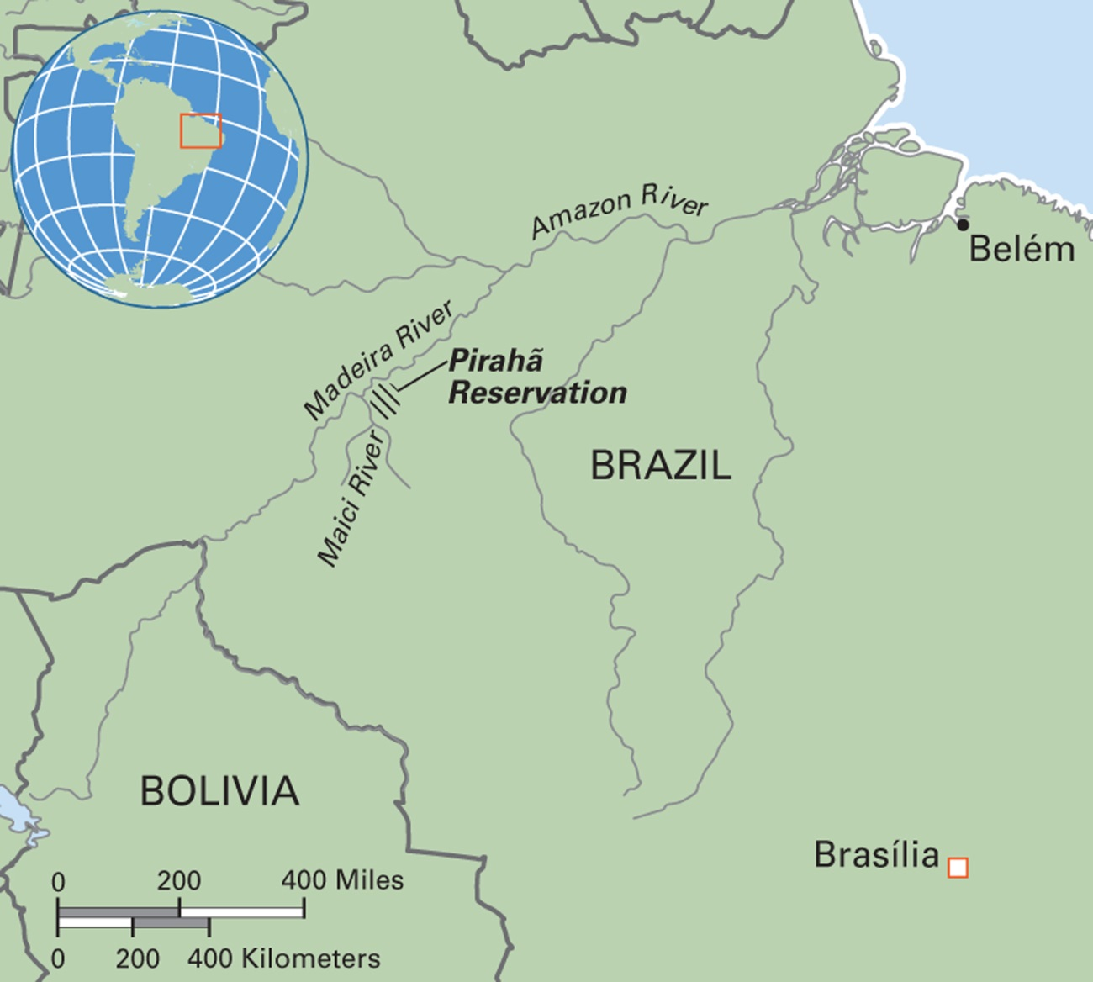
Map 11.1 Pirahã Reservation in Brazil
Notes:
Linguistic anthropologist Daniel Everett helped to define the boundaries of the Pirahã reservation in the 1980s. With support from Cultural Survival and other groups, the demarcation was legally declared in 1994.

Slide 8
Language and Verbal Communication (4 of 4)
Three ways of formally analyzing language:
  Sounds
    Study of phonemes and phonetics
  Vocabulary
    Ethnosemantics
  Grammar or syntax

Slide 9
Anthropology Works:
Narrating Troubles
Telling one’s trauma narratives as healing strategy
Victims of extreme violence during war in former Yugoslavia
Refugees in the United States
Narration of experiences helps reduce post-traumatic stress
May not be helpful with all cultural groups

Slide 10
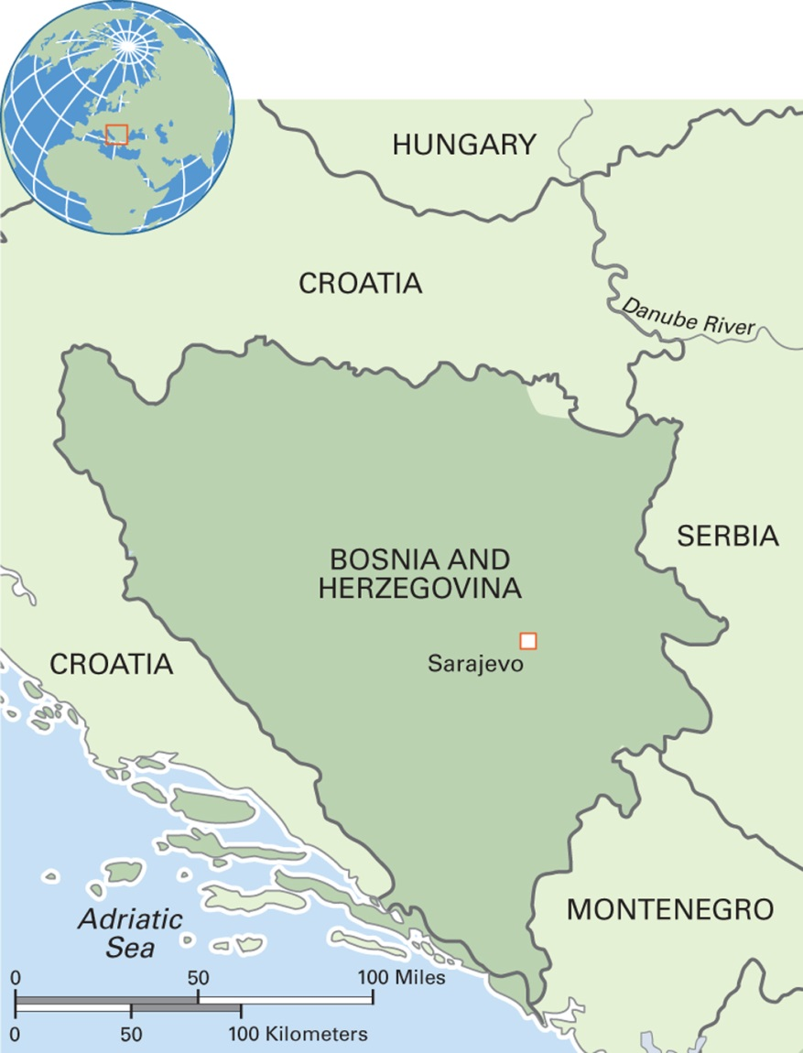
Map 11.2 Bosnia and Herzegovina
Notes:
Formerly part of the Socialist Federal Republic of Yugoslavia, Bosnia and Herzegovina have a population of around four million. Bosnia occupies the northern areas of the country, about four-fifths of the total area, whereas Herzegovina occupies the southern part. The country still faces the challenges of reconstruction following the war of 1992–1995. On a brighter note, it has one of the best income equality rankings in the world.

Slide 11
Nonverbal Language
Sign language: uses mainly hand gestures to communicate; culturally variable
Gestures
Silence
  Example: the Western Apache of Arizona
Body language including dress, hairstyles, posture, eye contact

Slide 12
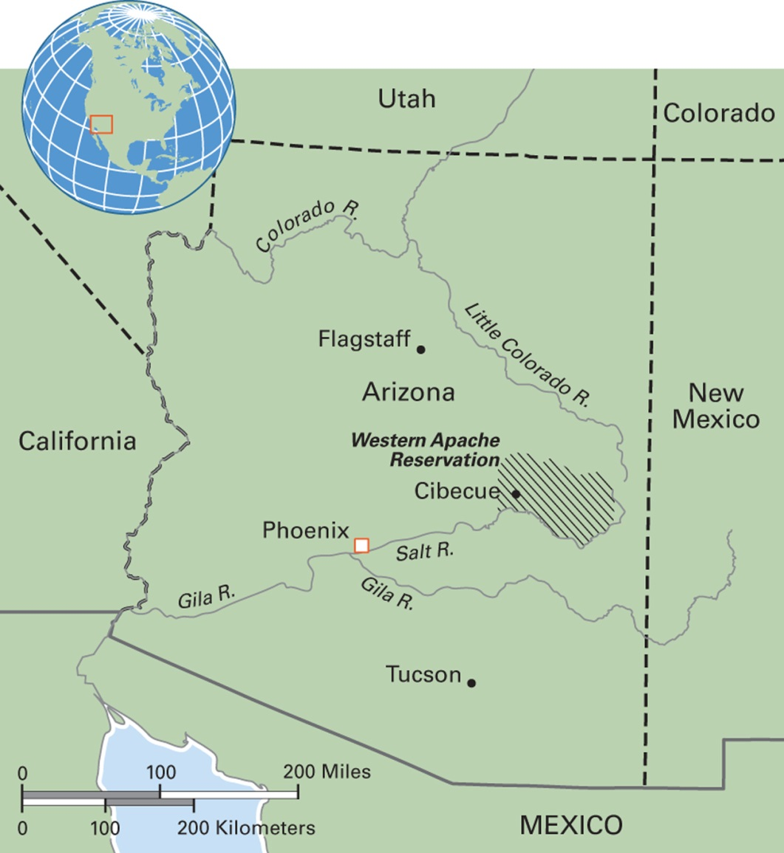
Map 11.3 Western Apache Reservation in Arizona
Notes:
Before European colonialism, the Apache lived in a wide area extending from Arizona to northwestern Texas. Originally foragers, they started planting some food crops in the 1600s. After the arrival of the Spanish, the Apache gained horses from them and became skilled equestrian warriors. In the second half of the nineteenth century, the U.S. government exterminated many Apache groups and forced those who survived to live on reservations to make way for White settlements.

Slide 13
Communicating with Media and Information Technology (1 of 3)
Media anthropologists
  Study the media process and content, the audience response, and the social effects of media presentations
Critical media anthropologists
  Ask to what degree access to media messages is liberating or controlling, and whose interests the media serve

Slide 14
Communicating with Media and Information Technology (2 of 3)
Advertising for Latinos in the United States
  Study showed Latinos treated as unified, culturally specific market
  Dominant trope is “the family”
  The version of Spanish used is generic, with no regional idioms or accent

Slide 15
Communicating with Media and Information Technology (3 of 3)
Digital divide refers to social inequality in access to new and emerging information technology and forms of communication
Local and global attempts to “cross the digital divide”
  Example: telecottages in Hungary

Slide 16
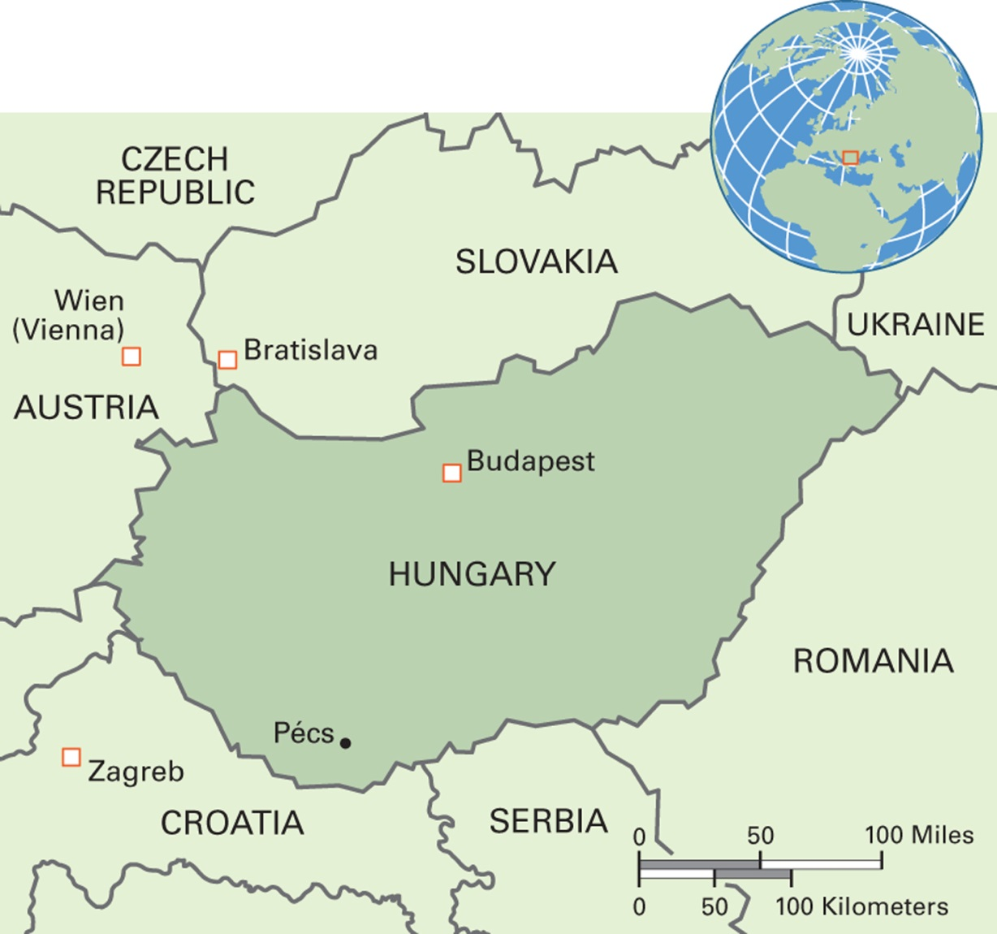
Map 11.4 Hungary
Notes:
The Republic of Hungary has a population of around 10 million. The Roma population, variously estimated at between 450,000 and 600,000, has increased rapidly in recent years. Hungary’s landscape is mainly plains with hills and low mountains to the north. One of the newest members of the European Union, Hungary has a growing economy. The main religion is Christianity, with Catholicism accounting for half of the total, while about 30 percent are atheists. Magyar, the Hungarian language, is one of the few European languages that does not belong to the Indo-European language family, but belongs instead to the Finno-Ugric family.

Slide 17
Language, Diversity, and Inequality
11.2 Discuss how communication relates to cultural diversity and social inequality.
Language and Culture: Two Theories
Critical Discourse Analysis: Gender and “Race”

Slide 18
Language and Culture: Two Theories
Sapir–Whorf hypothesis
  Language determines how we see the world and behavior
  People who speak different languages inhabit different “thought worlds”
Sociolinguistics
  Social position determines the content, meaning, and form of language

Slide 19
Critical Discourse Analysis:
Gender and “Race” (1 of 8)
Discourse
  Culturally patterned verbal language including varieties of speech, participation, and meaning
Critical discourse analysis
  An approach within linguistic anthropology that examines how power and social inequality are reflected and reproduced in communication

Slide 20
Critical Discourse Analysis:
Gender and “Race” (2 of 8)
Class and Accent in New York City
  William Labov’s research used informal observation of sales clerks’ speech in New York City department stores (a mix of stores catering to different income ranges)
  One finding was that the use of the consonant “r” was associated with class

Slide 21
Critical Discourse Analysis:
Gender and “Race” (3 of 8)
Gender in Euro-American Conversations
  Studies revealed differences in speech
    Compared with men, Euro-American women’s speech:
      Is more polite
      Uses rising intonation at end of sentences
      Makes frequent use of tag questions
    Men interrupt more frequently
  Different conversational styles of Euro-American men and women may lead to miscommunication (Tannen)

Slide 22
Critical Discourse Analysis:
Gender and “Race” (4 of 8)
Gender and Politeness in Japanese, and Those Naughty Teenage Girls
  Politeness and gender are reflected in the Japanese language
    Example: women refer to objects with prefix o-, men do not
  Kogals are young Japanese women who flout convention and also make use of emoticons

Slide 23
Critical Discourse Analysis:
Gender and “Race” (5 of 8)
“Fat Talk” among Euro-American Adolescent Girls
  Study of high school girls in the United States demonstrated preoccupation with body weight in conversation
  “Fat talk” describes a discourse pattern in which an exaggerated claim of obesity is made by one girl, followed by denial from her peers
    Function of the exchange?

Slide 24
Critical Discourse Analysis:
Gender and “Race” (6 of 8)
Gay Language and Belonging in Indonesia
  “Bahasa gay” includes a distinct vocabulary and plays humorously on elements of the standard language, bahasa Indonesia
  Conveys agency and freedom from official control
  Elements of bahasa gay are moving into the mainstream

Slide 25
Critical Discourse Analysis:
Gender and “Race” (7 of 8)
Cuing among the Akwesasne Mohawks
  Akwesasne (Mohawk) Indians use frequent nonlinguistic cues when discussing health problems
  Care providers misinterpret the cues as indecisiveness and noncooperation
  Cuing is in fact a sign of respect

Slide 26
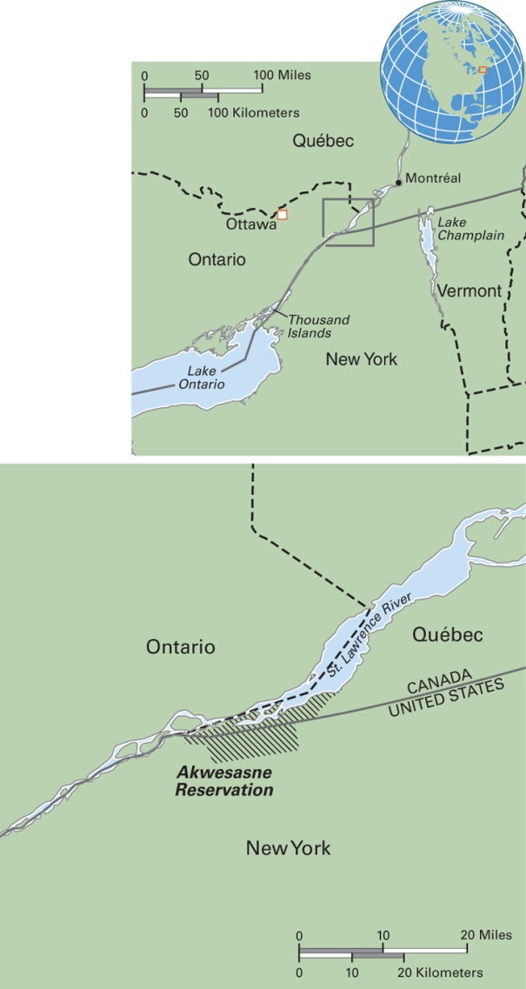
Map 11.5 Akwesasne Territory in New York State, Ontario Province, and Québec Province
Notes:
The Akwesasne Territory has an international border running through it with New York State on one side and two provinces of Canada on the other: Ontario and Québec. The Mohawk Council of Akwesasne comprises 12 District Chiefs and a Grand Chief. Since the 1960s, the Akwesasne Territory has been negatively affected by environmental pollution of the water, soil, and food supply from industries along the St. Lawrence River. In 1987, the Akwesasne formed a Task Force to restore and protect the environment and the survival of their culture.

Slide 27
Critical Discourse Analysis:
Gender and “Race” (8 of 8)
African American English: Prejudice and Pride
  Linguistic conservatives support teaching of Standard American English in schools to African American children and no attention to AAE as they believe it is a substandard language
  AAE supporters say it is a language in its own right
  AAE child speakers face becoming bilingual in school
  Teachers need to recognize this and build on AAE strengths while also teaching standard English

Slide 28
Language and Communication Change
11.3 List examples of language change.
The Origins and History of Language
Historical Linguistics
Colonialism, Nationalism, and Globalization
Endangered Languages and Language Revitalization

Slide 29
The Origins and History of Language
Verbal language developed between 100,000 and 50,000 years ago
Writing systems developed in the fourth millennium BCE

Slide 30
Historical Linguistics (1 of 4)
Study of language change through time
Concept of language families
  Example: the Indo-European Language Family
Role of migration
  Bantu languages in Africa

Slide 31
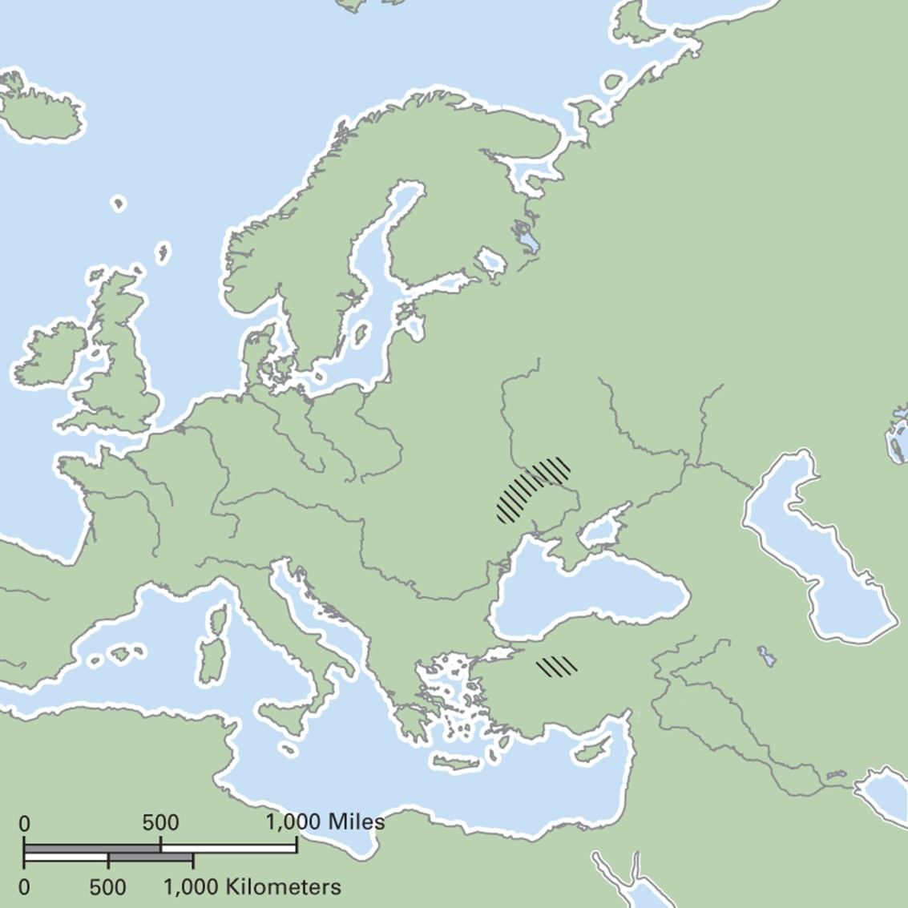
Map 11.6 Two Sites of Proto-Indo-European Origins
Notes:
Two major theories about the location of PIE exist, with the site south of the Black Sea considered to be earlier.

Slide 32
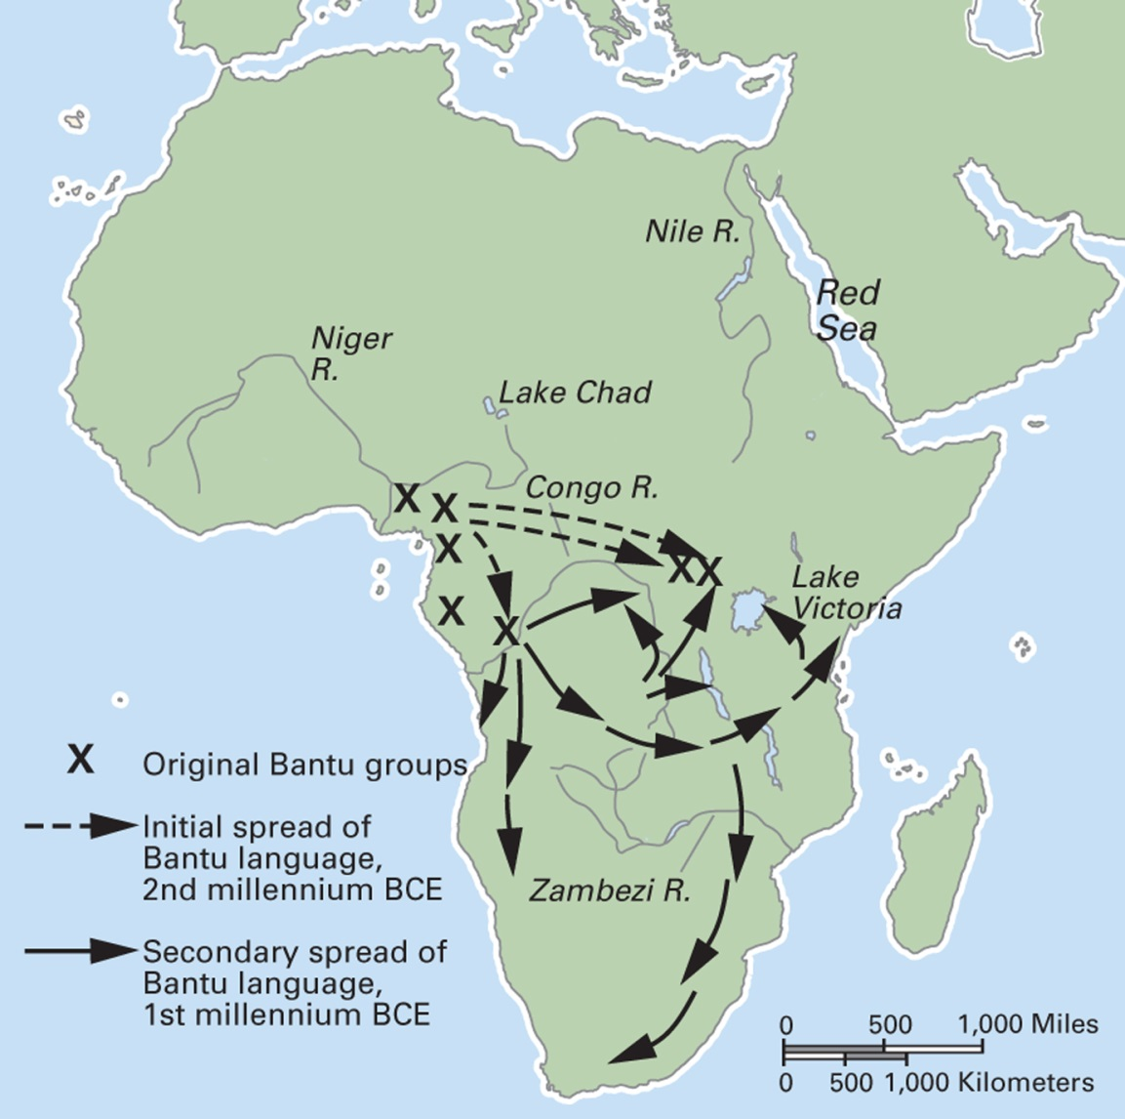
Map 11.7 The Bantu Migrations in Africa
Notes:
Linguistic evidence for the migrations of Bantu-speaking people relies on similarities between languages in parts of eastern, central, and southern Africa and languages of the original Bantu homeland in West Africa. Over 600 African languages are derived from Proto-Bantu.

Slide 33
Historical Linguistics (2 of 4)
Evidence of earliest writing from Mesopotamia, Egypt, and China
  Logographs: signs that convey meaning
Writing and the rise of the state
  An empire without writing:
    Khipu among the Inca

Slide 34
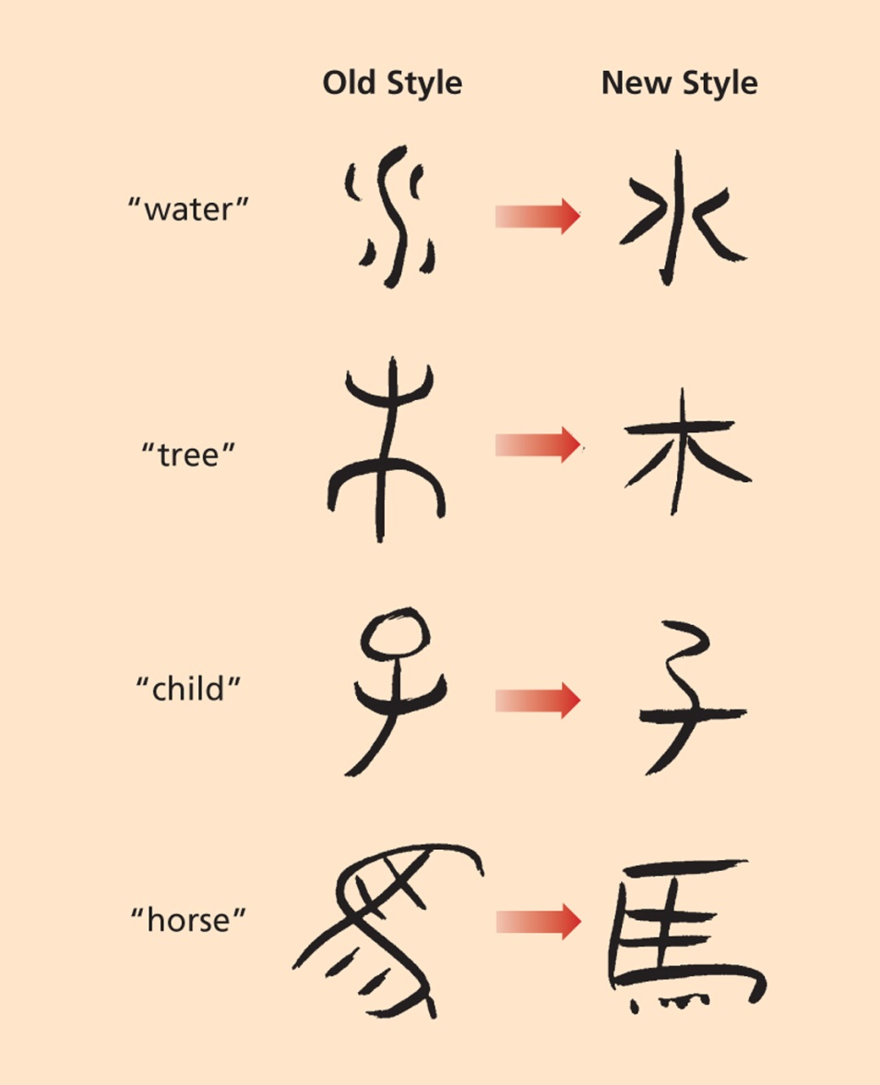
Historical Linguistics (3 of 4)
Notes:
Logographic and current writing styles in China.

Slide 35

Historical Linguistics (4 of 4)
Notes:
Khipu, or knotted strings, were the basis of state-level accounting in the Incan empire. The knots conveyed substantial information to those who could interpret their meaning.

Slide 36
Colonialism, Nationalism, and Globalization (1 of 3)
Effects of colonialism
  Major and varied effects on change in communication and language
  Pidgins
    Usually limited to functional domains; for example, trade
    Many have developed into creoles and even national languages
  Spread of English and other colonial languages
  Widespread linguistic pluralism and language borrowing

Slide 37
Colonialism, Nationalism, and Globalization (2 of 3)
Effects of nationalism
  Repression of local languages as nations work to assimilate minorities and indigenous peoples
    Direct methods include the declaration of a standard language and rules about language instruction in schools
    Indirect methods include discriminatory hiring on the basis of language

Slide 38
Colonialism, Nationalism, and Globalization (3 of 3)
Effects of globalization
  Continued borrowing of words, phrases
  Increased growth and spread of world/global languages
  Continued decline of indigenous and small languages through loss of speakers; many languages going extinct

Slide 39
Culturama: The Saami of Sápmi, or Lapland (1 of 2)
Indigenous people who live in the northernmost stretches of Norway, Sweden, Finland, and western Russia
Herding domesticated reindeer was the economic mainstay
Reindeer pastoralism has declined to about 10 percent of the population
Now people are farmers or work in trade, small-scale industry, handicrafts, services

Slide 40
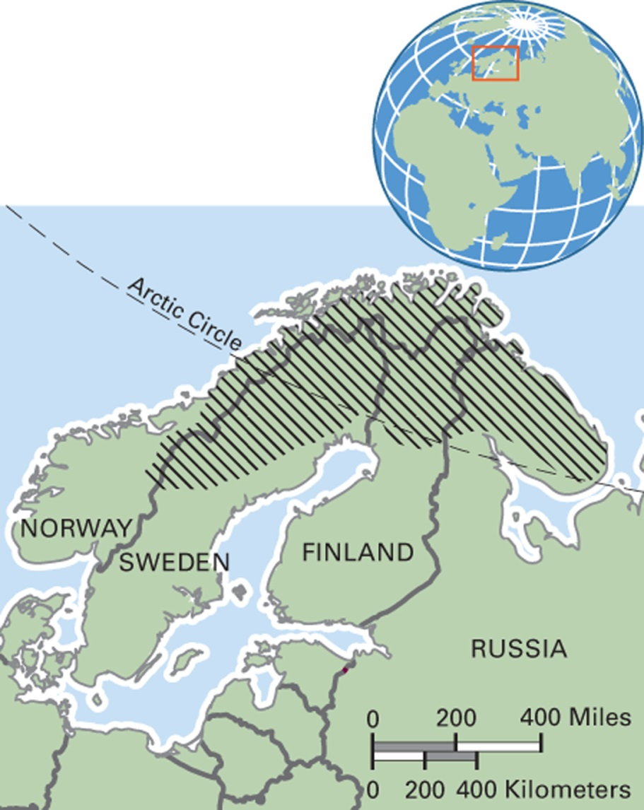
Map 11.8 The Saami of Sápmi, or Lapland
Notes:
Sápmi extends across Norway, Sweden, Finland, and Russia’s Kola Peninsula.

Slide 41
Culturama: The Saami of Sápmi, or Lapland (2 of 2)
Saami have experienced discrimination, exclusion, loss of territorial rights, and cultural and linguistic repression
Language is of central cultural value to the Saami, and efforts to maintain it have been under way since the 1960s
The yoik, a traditional song form, is of particular value

Slide 42
Endangered Languages and Language Revitalization (1 of 2)
Scholars have proposed four phases of language loss
  Language shift: speakers have a limited vocabulary in their “native” language and may be more fluent in a secondary one
  Language endangerment: a language has fewer than 10,000 speakers
  Near-extinction: only a few elderly speakers remain
  Language extinction: the language has no competent speakers

Slide 43
Endangered Languages and Language Revitalization (2 of 2)
Revitalization efforts
  May be opposed by governments that fear identity movements
Strategies for revitalization efforts
  Formal classroom instruction
  A master–apprentice system
  Web-based tools and services

Slide 44
Think Like an Anthropologist: Should Dying Languages Be Revived? (1 of 2)
YES: Argument for revival based on demonstrated links between language survival, cultural survival of groups with local/ traditional knowledge and biological/environmental survival
  A sign of a culturally healthy planet
  Language is an intrinsic part of culture
  Dying cultures and dying languages are treasures lost forever

Slide 45
Think Like an Anthropologist: Should Dying Languages Be Revived? (2 of 2)
NO: Darwinian view says that languages, like species, have to compete; losers die out and the strong survive, so it is wasteful to support programs to help dying languages survive

